Slide 1
HyperNatremia
Osmolality/Tonicity: | Hypotonic < 280 mOsm/kg | Iso-tonic 280-295 mOsm/kg | Hyper-tonic > 295 mOsm/kg
Na mEq/L: | Hypo-natremia < 130 mEq/L | Normal Na 135 – 145 mEq/L | Mild Hyper-Natremia 145 – 150 mEq/L Severe Hyper Na > 160 mEq/L
Corrected Na if Glucose > 100:
Corrected Na = 123 +
Glucose - 100
100
* 1.7

Slide 2
If Hypernatremia
Then
Pt will always be hypertonic due to increase in Na
Assess Volume
 | Hypo-volemic Hypertonic Hypernatremia | Eu-volemic Hypertonic Hypernatremia | Hyper-volemic Hypertonic Hypernatremia
Description | Na ⬇⬇Fluid | ⬇Fluid | ⬆⬆Na ⬆Fluid
Result | Fluid loss > Na loss Concentrated | Concentrated Na | Concentrated Na
Cause | Renal, GI, Adrenal | Diabetes Insipidus (DI) | Sodium overload Mineralocorticoid excess
Tx | Isotonic Crystalloids |  | D5W + Loop
Nephrogenic DI: kidney can’t respond to ADH
Decrease Na intake
Central DI: low ADH
Desmopressin or Vasopressin
Notes:
Low Na, Low fluid
Low Na, some fluid
High Na, a lot of fluid (dilutes

Slide 3
Monitor:
Na q4 hours
Reduce by 1 mEq/L per hour
Or
10 mEq/day
Goal:
Na < 145 mEq/L

Slide 4
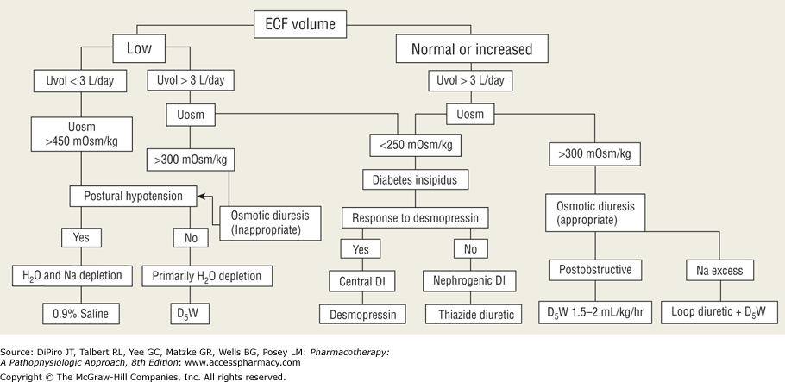
Diagnostic and treatment algorithm for the hypernatremia

